Slide 1
App Store Game Trends
CS 4650 Capstone Project:
Minwoo Soh
Salvatore Grillo

Slide 2




Technologies Used
Cloud Platform used: XSEDE
Ease of use
Spark for Map Reduce
Preference
Google Colab for communicating
Google Drive for file storage

Slide 3

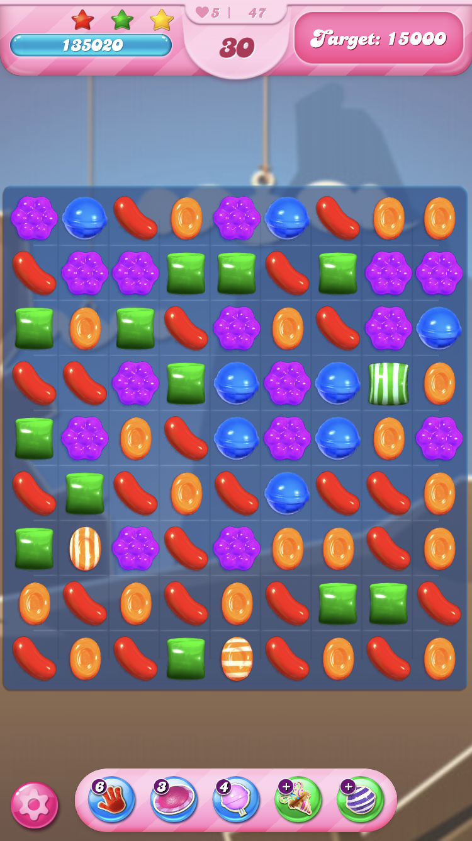
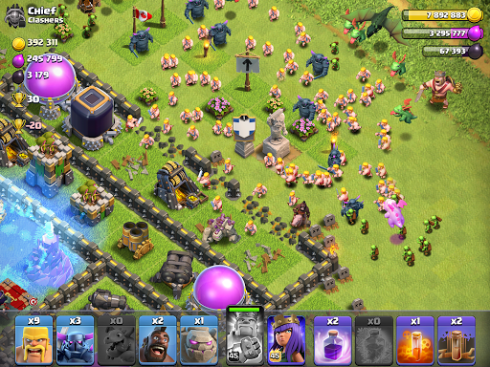
Our Dataset:
Mobile Strategy Games Data
17007 strategy games on the Apple App Store. It was collected on the 3rd of August 2019, using the iTunes API and the App Store sitemap.
18 Columns:
App’s URL
ID
Name
Subtitle
Icon URL
Average User Rating
User Rating Count
Price
In-app Purchases
Developer
Age Rating
Languages
Size
Primary Genre
Original Release Date
Current Version Release Date
Description

Slide 4
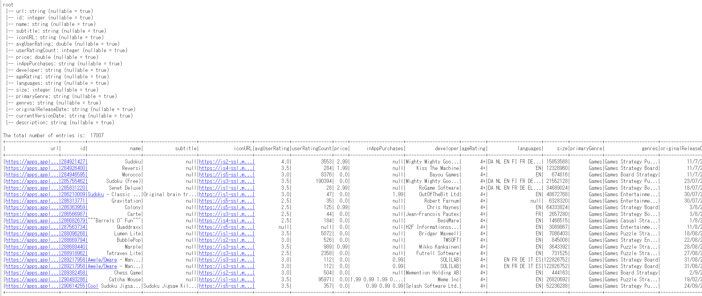

Slide 5
Application for Analysis
Distribution Platforms:
What are good indicators that an mobile game app will be successful as soon as it is uploaded?
Identify games with potential and put them in front page where users can easily find them.
Game Developers:
Understanding game trends to create a game that can attract the most users.
What Genre is currently the most popular?

Slide 6
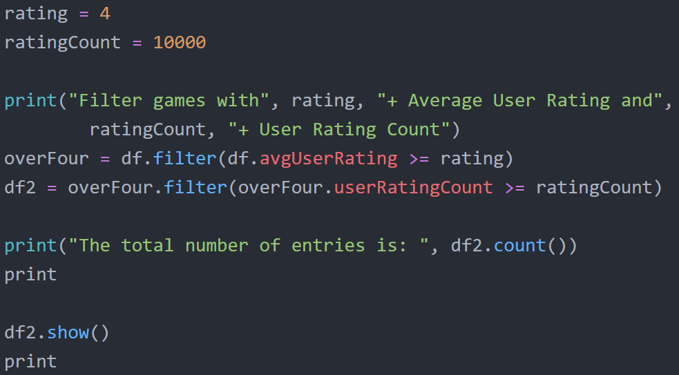
Filtering Data
Most games in this dataset have low average ratings and low user rating counts. Not good indicators of a popular game.
Parse data so only games with 4.0+ average ratings are accepted.
Parse data again so only games with high user rating counts (10,000+) are accepted. If many people played the game and rated it, then its average rating should be reliable.

Slide 7
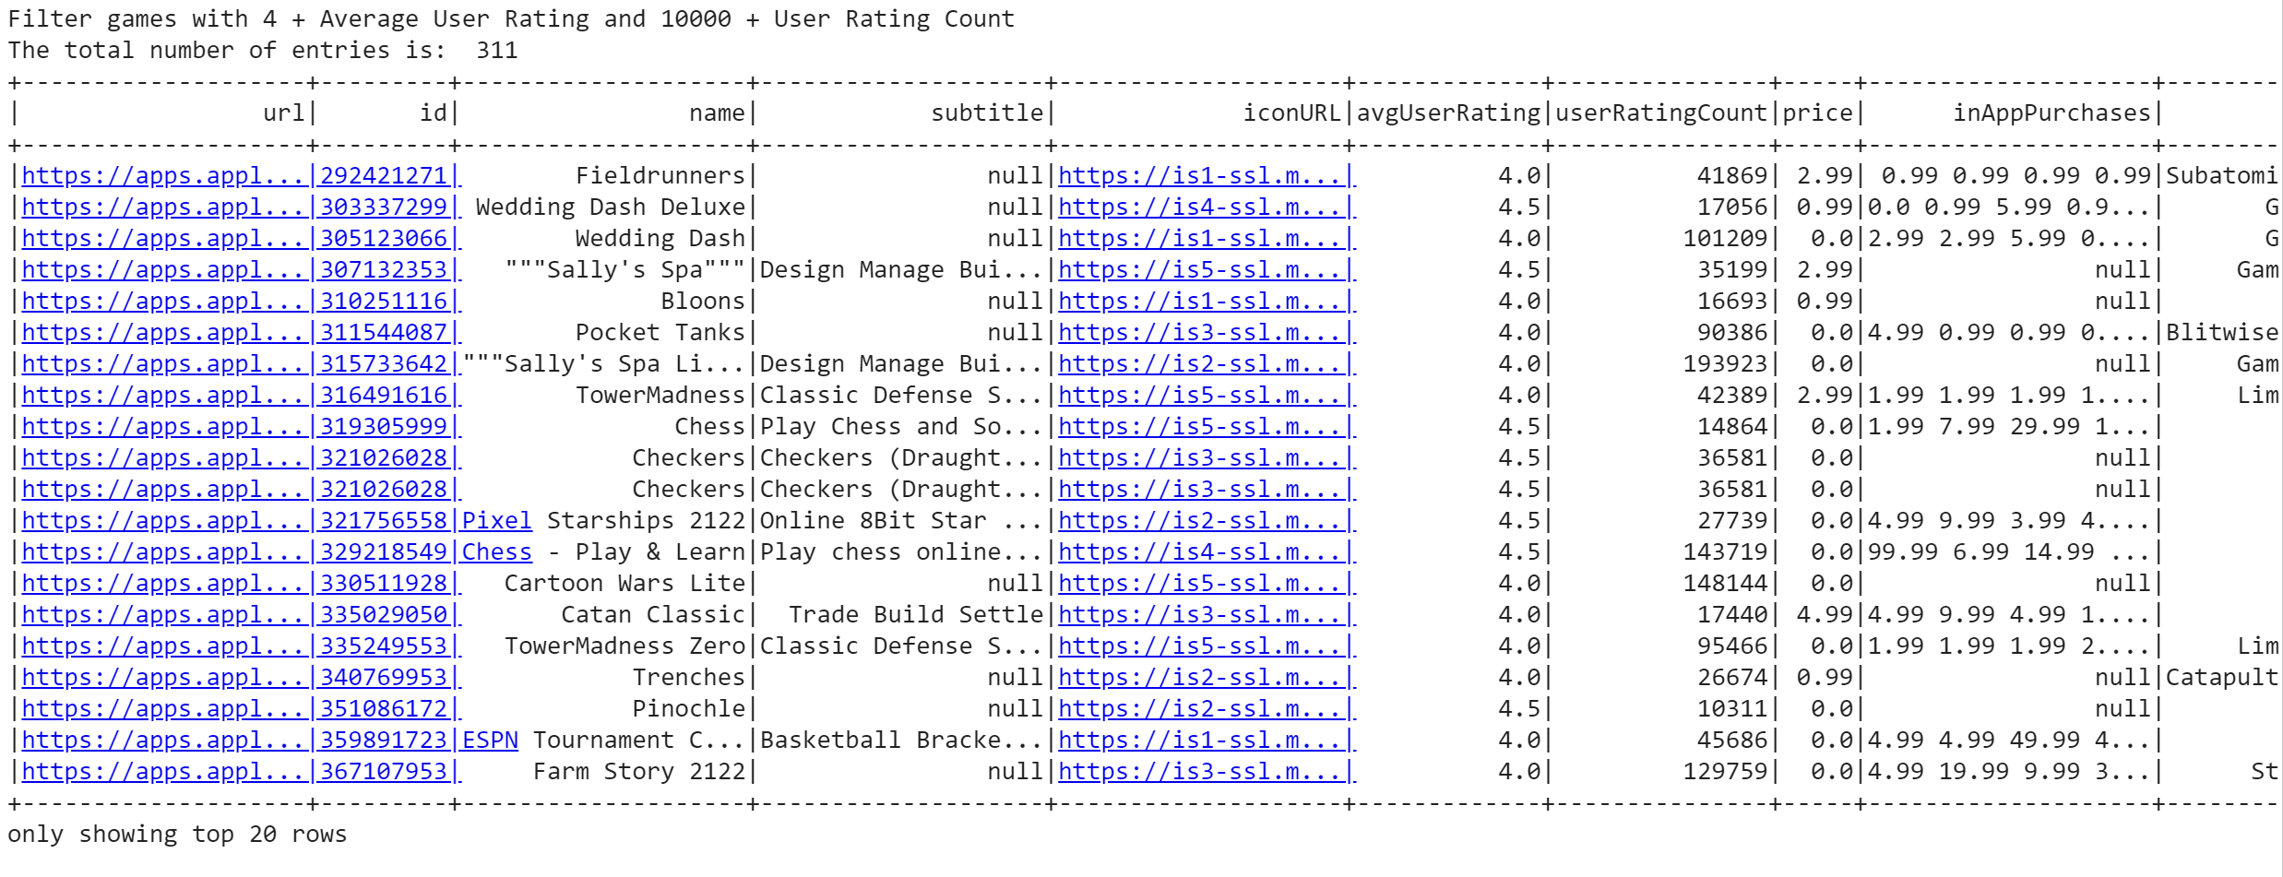
Filtered Data

Slide 8
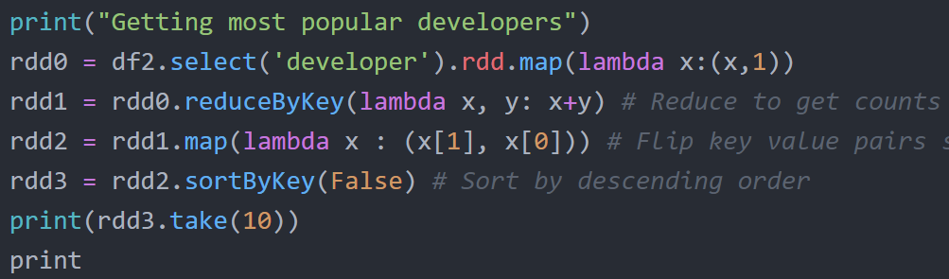
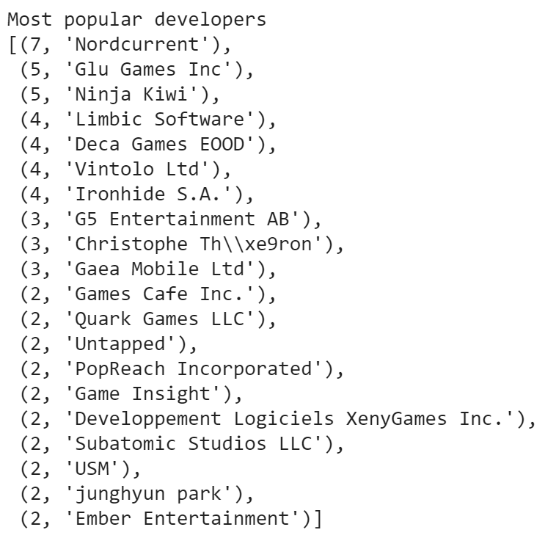
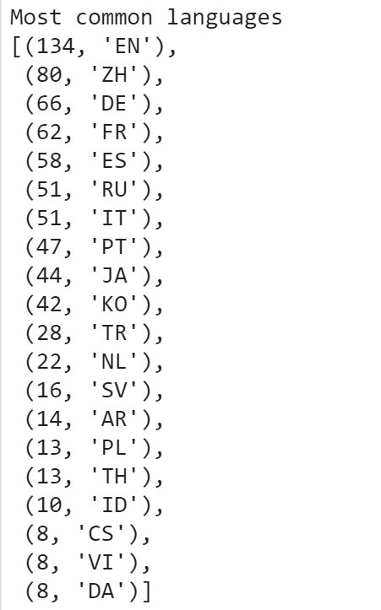
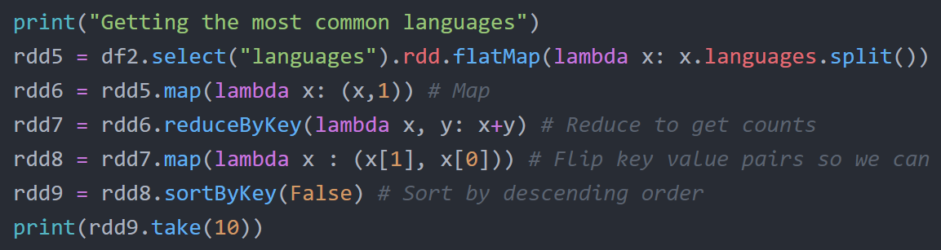
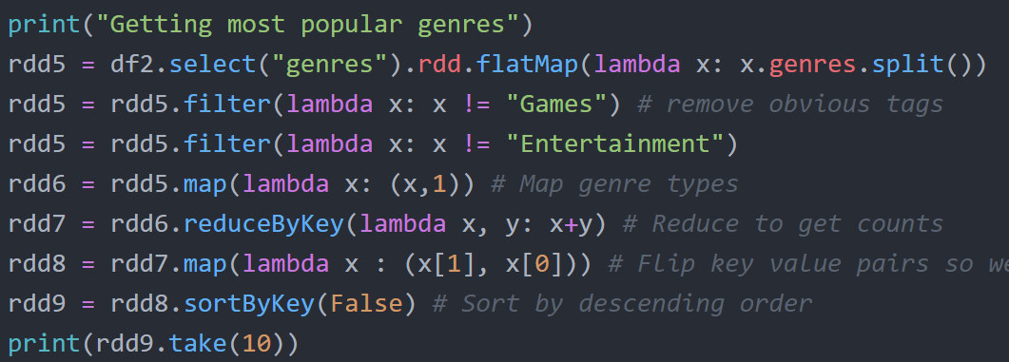
Map Reduce

Slide 9
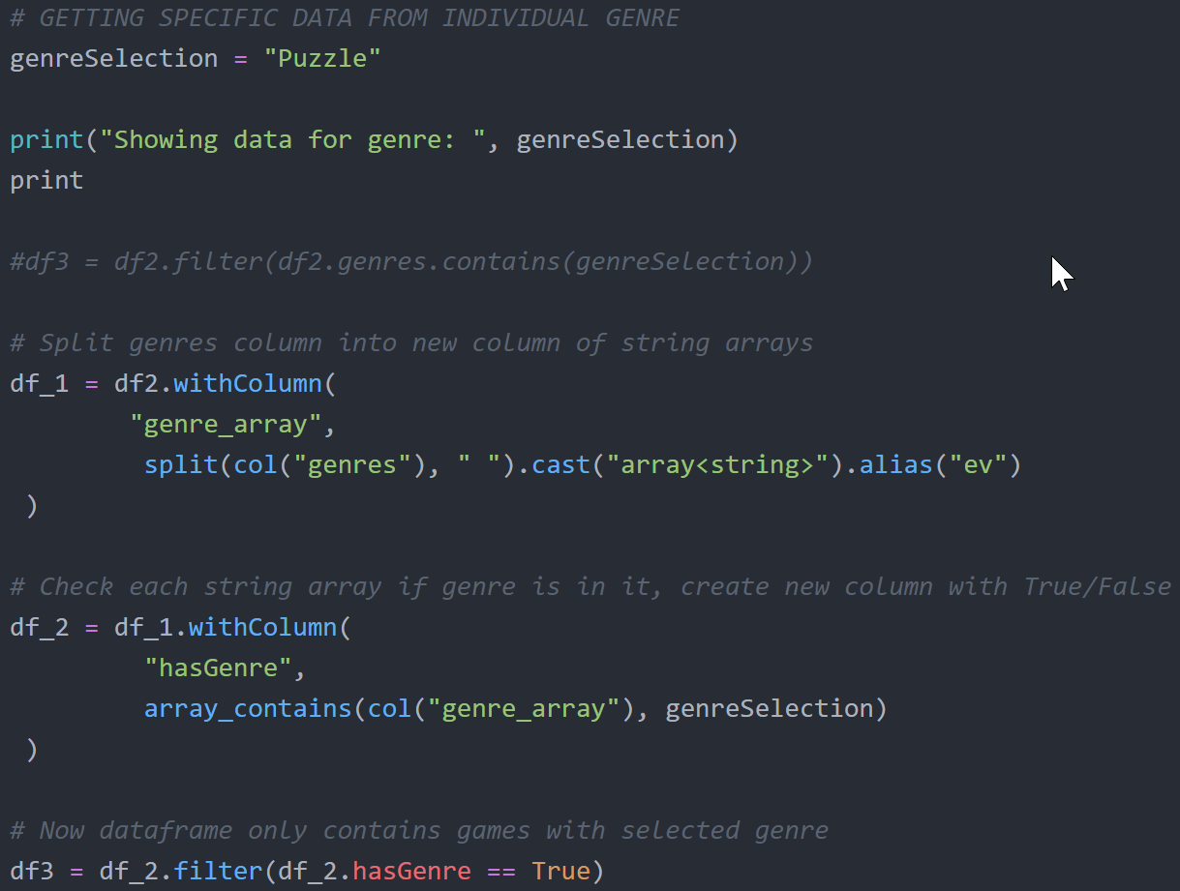
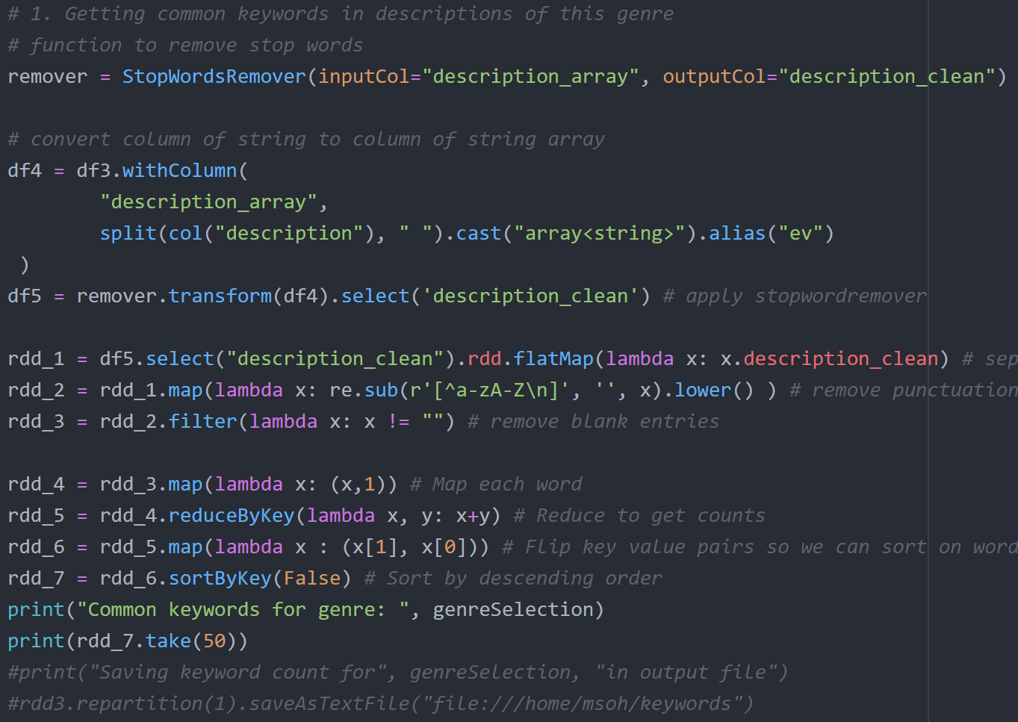
Description Keywords From Each Genre
Filter data for selected genre
Remove stop words and blanks, then map reduce

Slide 10
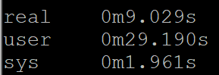
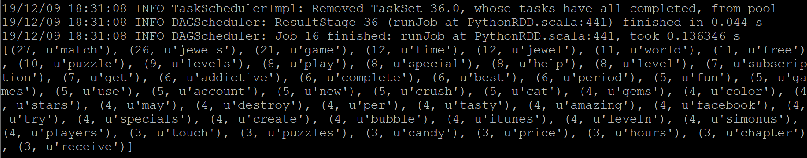
Results on XSEDE
Long description will most likely contain many stop words (e.i. The, you, or, and, like, etc.)
Pyspark provides a convenient function “StopWordRemover” that removes stop words from an array of strings.
All resulting word count data for each category are saved in separate output files (genres, developers, languages, description keywords, age rating)
Execution time:

Slide 11
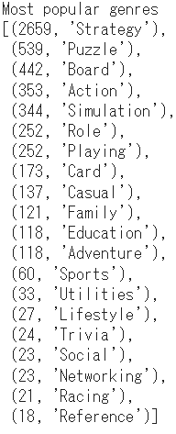
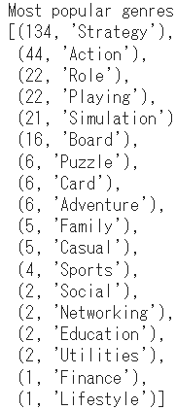
Genres and Subgenres
Left - Unfiltered Data
Right - Games with 4+ stars and >10,000 ratings
Conclusion
Common additions to the strategy genre are Puzzle, Board, Action, and Simulation
However, the more successful games tend to have Action and Role-playing as secondary genres
This tells us that making a game within these genres will result in a higher probability of success, as that is what users desire

Slide 12
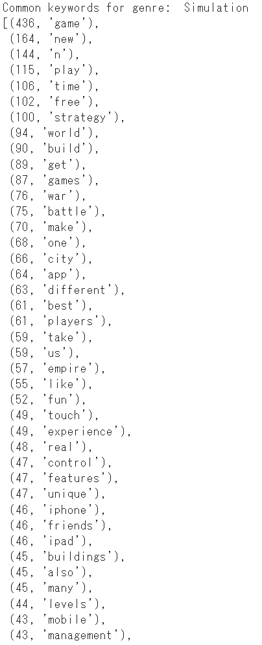
Simulation
From before, we saw that Simulation was a fairly popular genre
Keywords that are common within this genre include “World”, “Build”, and “Make”, which all suggest building based strategy games
Further down the list, but still fairly common are keywords like “War”, and “Battle” which also speaks to the prevalence of war simulators.

Slide 13
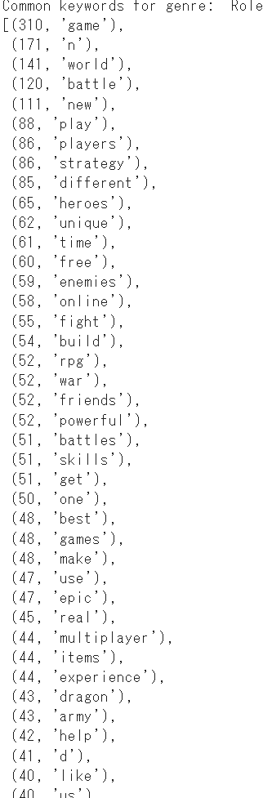
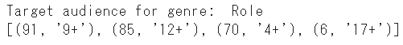
Role-Playing
Popular keywords within the Role-Playing genre include “ battle”, “world”, “heroes” and “skills”
Likely, this speaks to the trend of swords and sorcery style games that tend to inhabit the Role-Playing genre.
Interestingly enough, a few other keywords that are shared in common with the simulation inhabit this list as well. Keywords such as “build” and “army” seem to suggest fantasy based strategy building games.

Slide 14
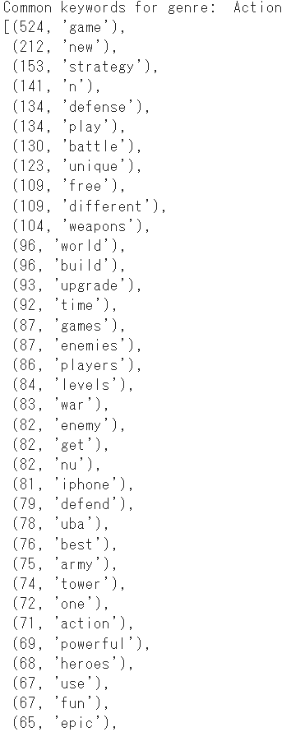
Action
Action is another bigger topic
Common keywords for this category include: “defense”, “weapons”, and “unique”
Likely, this plays to the strength of “action” titles, as such titles are often about violence and giving a sense of empowerment to the player.
Interestingly enough, action has a high crossover of words with simulation like “army” and “defend”

Slide 15
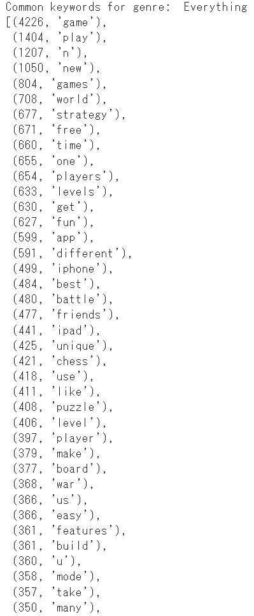
Everything
Out of curiosity, what are simply the most popular strategy games advertising?
One common one that sticks out is “free”, an important point to make if you are trying to be an up and coming developer
Ironically, “unique” is a popular
“Easy” and “fun” populate the list as developers are legally required to tell you this

